Slide 1


SHALE-OIL PRODUCTION RESILIENCE and ASSOCIATED SHALE-OIL RESERVES :
A GLOBAL APPROACH based on THE PETROLEUM SYSTEM
Marc BLAIZOT, June the 13th, 2017.
marc.blaizot@laposte.net

Slide 2
Presentation Highlights
Introduction : LTO Resilience ?
Oil retention and Global LTO Resources
Oil recovery and Global LTO Reserves
Conclusions : Where to go and for how long ?
LTO Definition follows D. Jarvie [2012] stating that “shale-oil is oil stored in organic rich intervals (the source rock itself) or migrated into juxtaposed organic lean intervals”.

Slide 3
Recent (2016) and unexpected Bakken LTO Production Resilience
In Kbopd
from US-EIA, April 2017, Bakken drilling productivity Report

Slide 4
Presentation Highlights
Introduction : LTO Resilience ?
Oil retention and Global LTO Resources
Oil recovery and Global LTO Reserves
Conclusions : Where to go and for how long ?
LTO Definition follows D. Jarvie [2012] stating that “shale-oil is oil stored in organic rich intervals (the source rock itself) or migrated into juxtaposed organic lean intervals”.

Slide 5
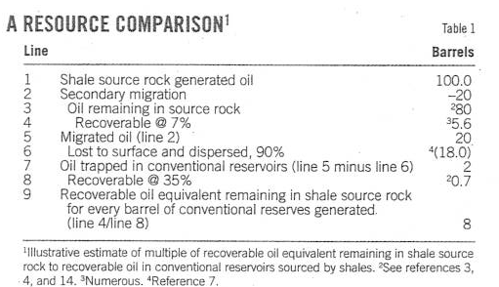
OIL Trapped in shale-oil : How much ?
From P.K. MEYER, O&G Journal, May 2012
80% trapped in SR!!!, 2% trapped in Conventional Reservoir ; 18% lost in migration ;
RF : 7% in SR , 35% in CR

Slide 6
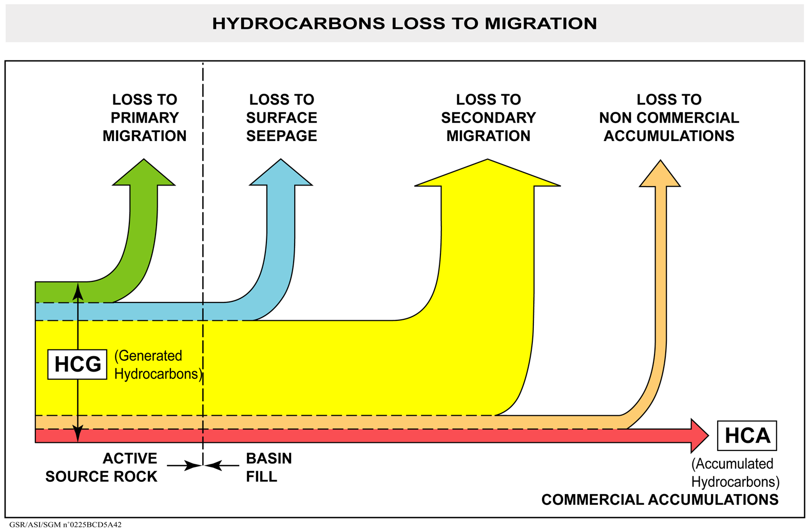
OUR “CLASSICAL PETROLEUM SYSTEM ASSUMPTIONS” : NO RETENTION ?
PSY is OK but WHERE IS THE RETENTION WITHIN SOURCE ROCK ?
* AFTER W. ENGLAND, AAPG MEMOIR 60, 1994
PSY = HCA / HCG

Slide 7
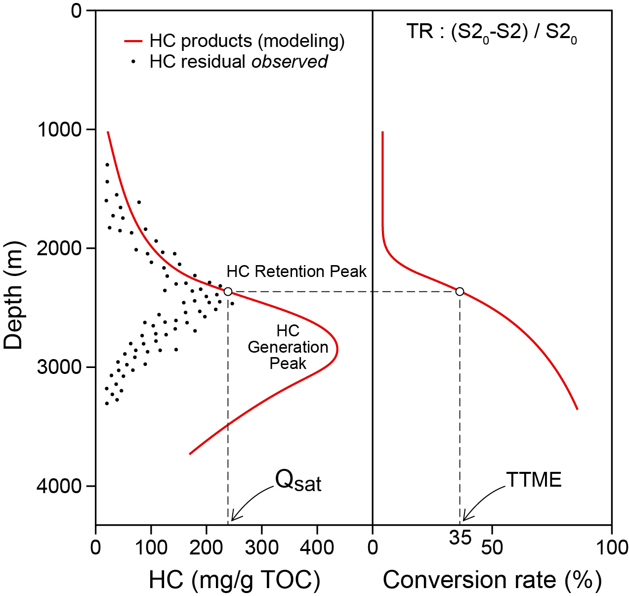
WHAT ARE INDICATING LAB MEASUREMENTS IN SOURCE-ROCKS?
Before Expulsion starts, sufficient hydrocarbons quantities have to be generated to saturate the kerogen porosity.
This amount is the Minimum Transformation Ratio to get Expulsion. This minimum could be also the maximum retention peak ?
Maximum values of hydrocarbon (S1) around 250g/gTOC ( Jarvie, AAPG 2012 in several SO in the USA)
And Hydrocarbon present are around 35 %of initial potential
from . ESPITALIE and E. LAFARGUE, 12/1996

Slide 8
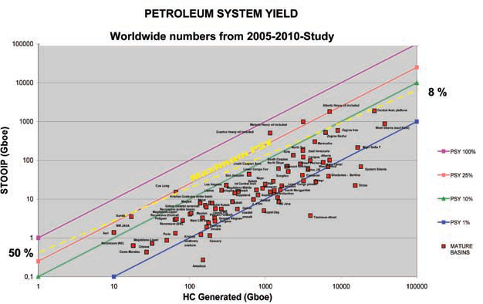
PSY VALUES FOR MATURE BASINS : PSY average : 5% but in EHO Belts (Orinoco, ALBERTA) : 50%
Are EHO Belts migration products, good proxy for migration products lost in other basins ?
Modified From JJ Biteau et al. , First Break , EAGE, November 2010

Slide 9
A GLOBAL APPROACH TO RETENTION in SOURCE ROCKS
Generation
7500/0.05 = 150000 Gb
Migration
Dismigration and losses
Conventional OOIP
3000/0.4 = 7500 Gb
OIP Retention in SR
150000/2 = 75000 Gb
Migration Loss = 45%
45 %
50 %
5%
50 %
PSY = 5%

Slide 10
Presentation Highlights
Introduction : LTO Resilience ?
Oil retention and Global LTO Resources
Oil recovery and Global LTO Reserves
Conclusions : Where to go and for how long ?
LTO Definition follows D. Jarvie [2012] stating that “shale-oil is oil stored in organic rich intervals (the source rock itself) or migrated into juxtaposed organic lean intervals”.

Slide 11
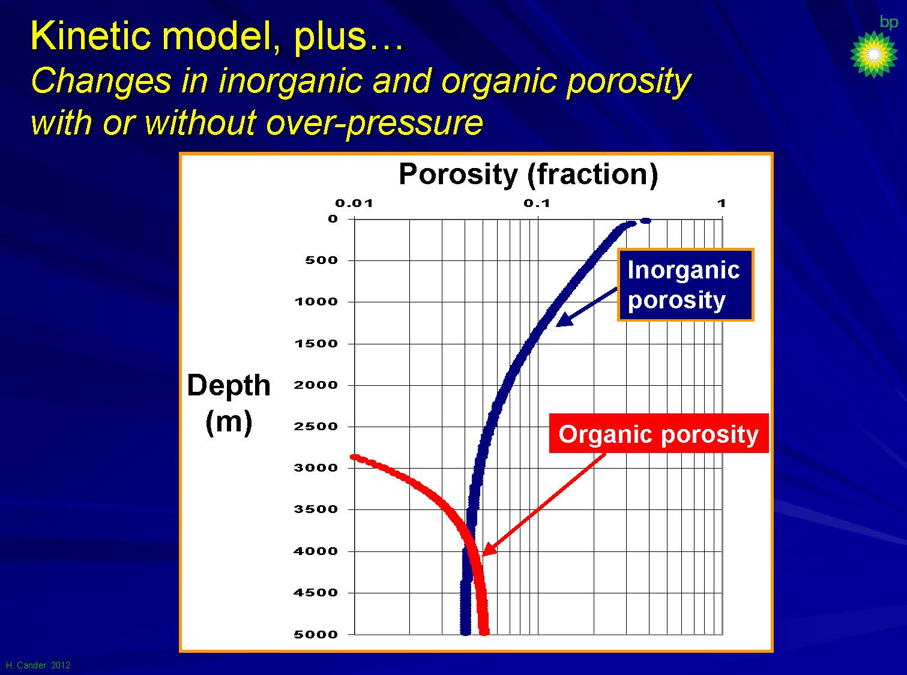
POROSITY WITHIN SHALES (Upper Cretaceous Eagle Ford Example)
Organic Porosity increasing with maturity !
TOC: 1.5 % in weight
TOC : 3% in volume
Organic Porosity :4 to 6%
Oil mainly adsorbed at or absorbed within Kerogen : high HC-wettability
Organic porosity is oil bearing
adapted from H. Cander (bp) , AAPG Annual Convention,April 2012

Slide 12
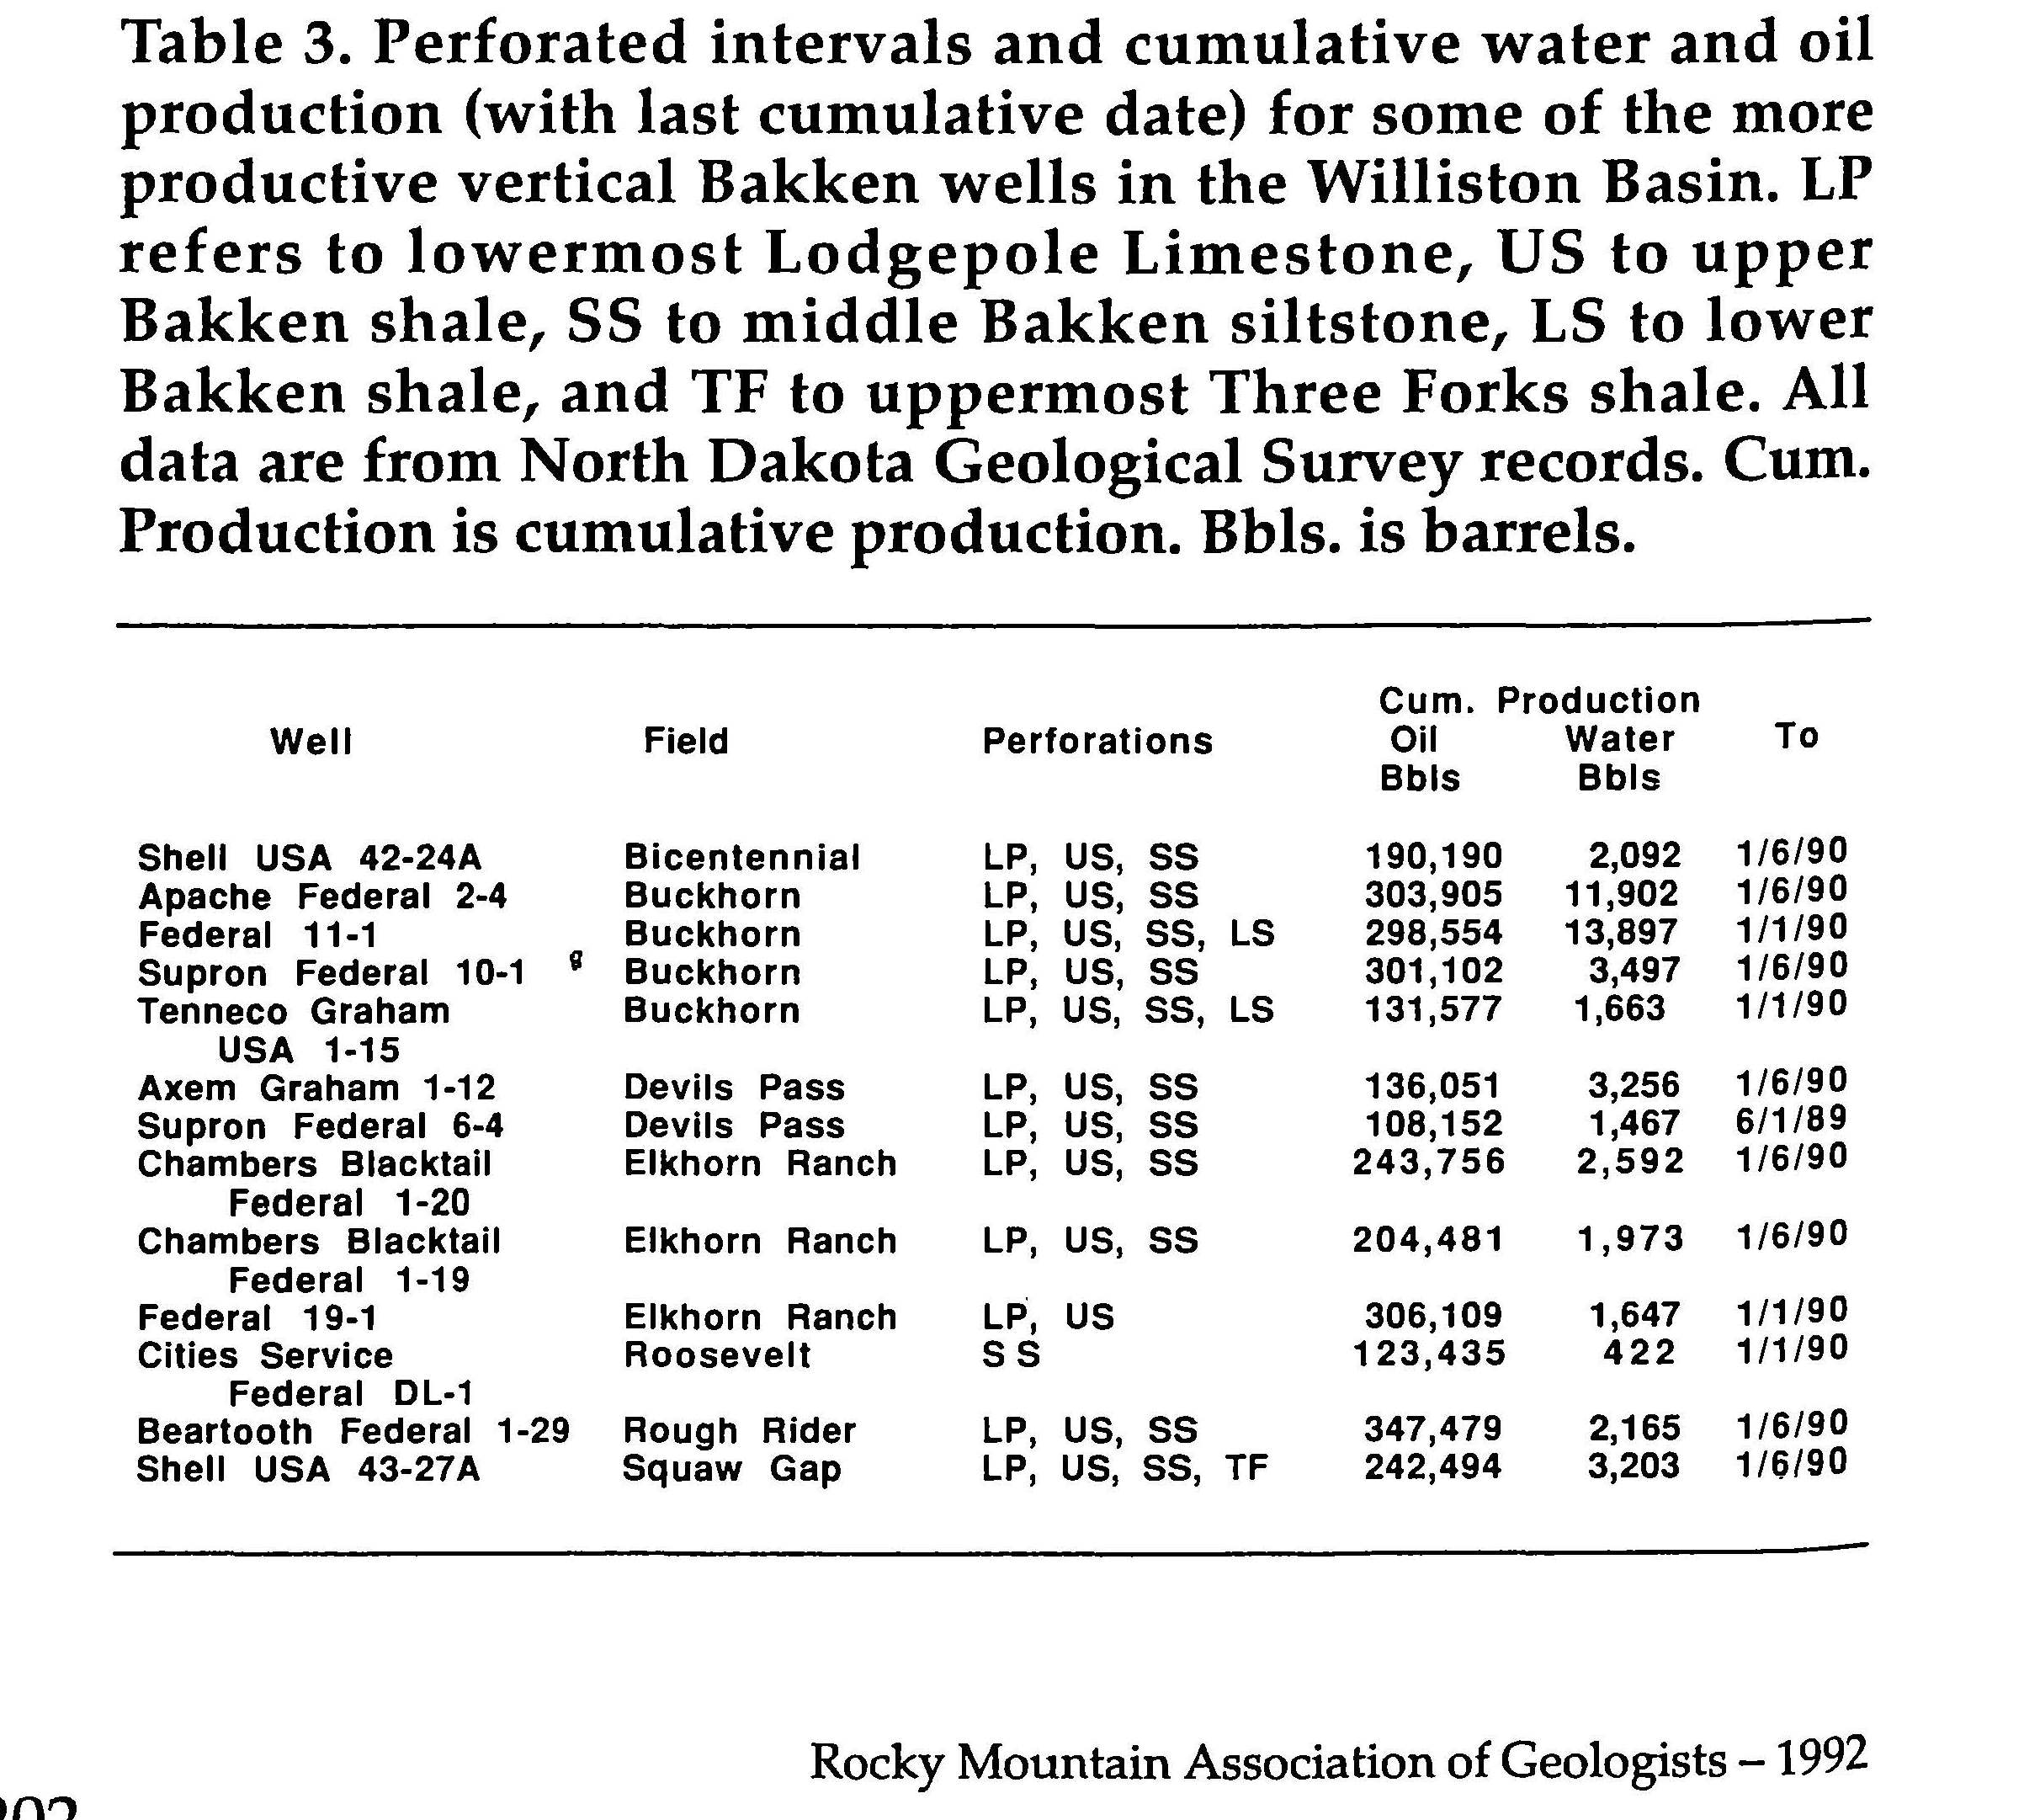
Oil SATURATION in SHALE OILS : the Bakken Example (1)
In the Bakken Shales
(Carboniferous/Devonian)
Water cuts in vertical wells drilled
and produced in the 80’s
= before hydraulic fracking
were very low (few %)
supporting a high So ;
Geochemical and petrophysical
studies invoke always
a hydrocarbon wet « reservoir »
Production table from L Price and J LeFever , USGS, 1992

Slide 13
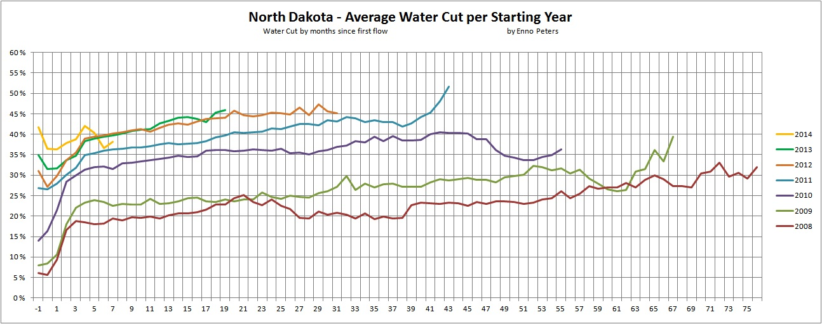
OIL SATURATION in SHALE OILS : The Bakken example (2)
Last drilled horizontal wells in Bakken show an increasing Water Cut for newer wells, from 20% (2008/2009) to 45 % (2012/2013)
Water Cut is a good indicator of the whole SR depletion and decreasing oil saturation (or increasing water venues through fractures)
But Water cuts are more stable with wells ages than previously thought
From http://fractionalflow.com post by Rune Likvern on December 2014

Slide 14
From Global LTO ressources to reserves
Assuming a 10 % Recovery Factor : 75000/10 = 7500 Gbo
Assuming a 20 % « acceptability » surface : 7500/5 = 1500 Gb
RF : Geology and geomechanics but also finances (100 $/b)
Acceptability : geography, environment, societal limitations

Slide 15
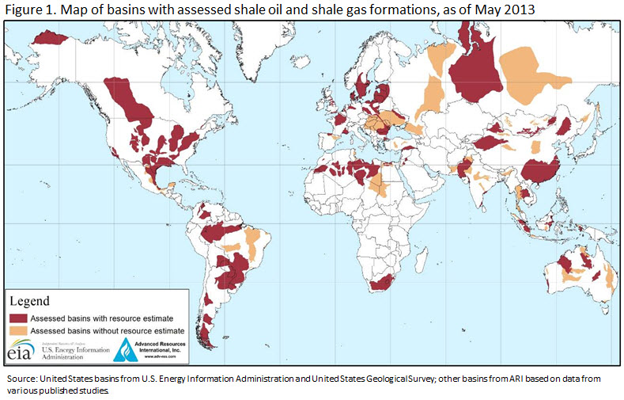
US-EIA 2013 Studies : 335 Gbo

Slide 16
335 GB of SHALE OILS RECOVERABLES RESERVES (EIA Reports, 2013) SEEMS to be DEEPLY UNDERESTIMATED
Only 137 SO formations in only 95 Onshore Basins considered
  All Middle East and Caspian basins excluded !
  Low quality (not really defined) areas are… discarded ;
  Light HC included in shales gas not in shales oil!
OOIP is Risked ; Risk factor is comprised between 60 % (Vaca Muerta) and 12 % (Parana) ; classical values : 20% (ex :Timimoun, Ahnet )
RF are low : between 2-4 % up to 6-8 % mainly based upon TOC (+ 2%) , Clay Content (Less than ?), Formation pressure (above Hydrostatics), moderate geological complexity (faulting)

Slide 17
Presentation Highlights
Introduction : LTO Resilience ?
Oil retention and Global LTO Resources
Oil recovery and Global LTO Reserves
Conclusions : Where to go and for how long ?
LTO Definition follows D. Jarvie [2012] stating that “shale-oil is oil stored in organic rich intervals (the source rock itself) or migrated into juxtaposed organic lean intervals”.

Slide 18
Conclusion (1) : Where shale we look for ?
Onshore sag and foreland basins with large type II transgressive SR seem the best candidates, excluding type III SR bearing deltaïc basins,
They correspond mainly to low faulted and pressured parts of horizontally drained basins according to Perrodon (1995).

Slide 19
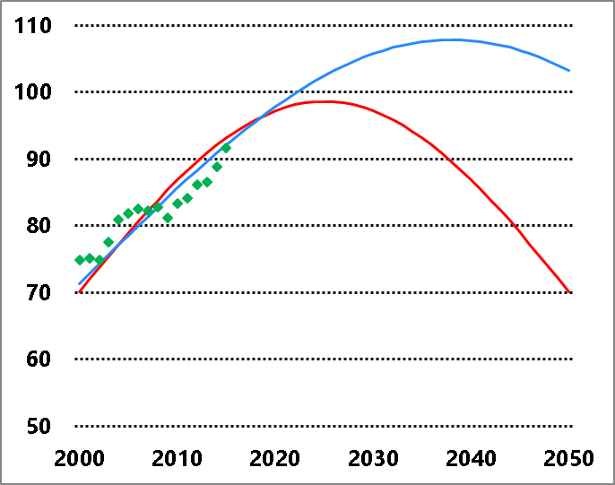
Conclusion (2) : For how long ?
Without new LTO
With new 1500 Gbo LTO at 100 $/b,
Daily oil production (Mbopd)
2025
2037

