Slide 1
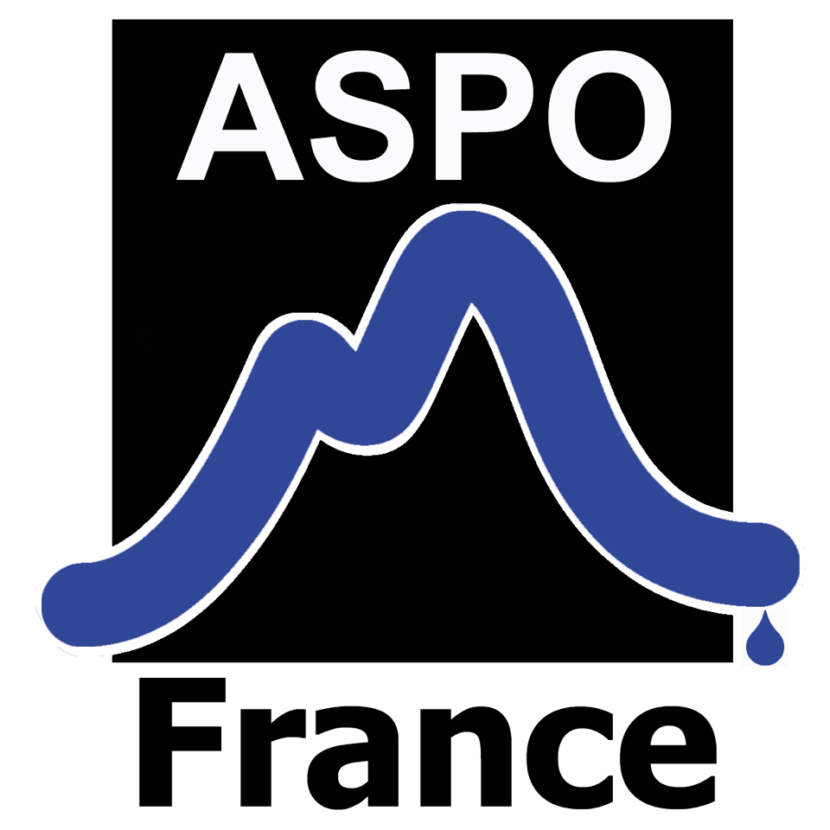
ASPO October , 2017
Unconventional Exploration and
Conventional New Projects
Marc Blaizot

Slide 2
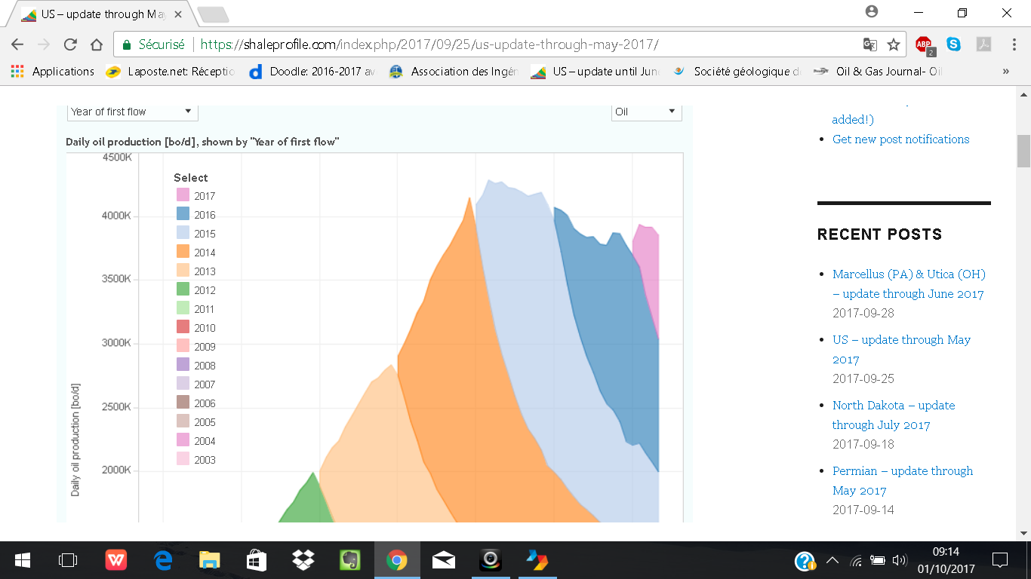
USA : Total US LTO Production ; peak at 4220 kbopd in Mars 2015 ; slight increase in 2017
Enno Peters
September 2017

Slide 3
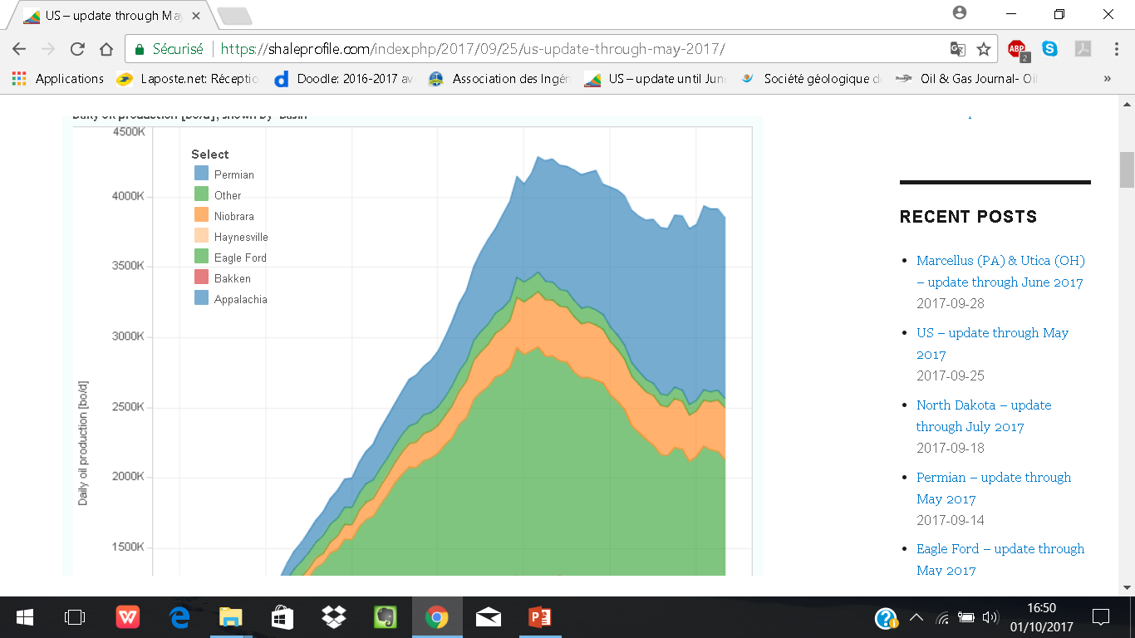
USA : LTO Production by Basins / decrease of production everywhere except Permian
Sharp decrease of the Eagle Ford between March 2015 and end 2016 at around 20%/y ! stabilization then
Permian increased from April 2015 to April 2017 at around 20 to 25%/Y

Slide 4
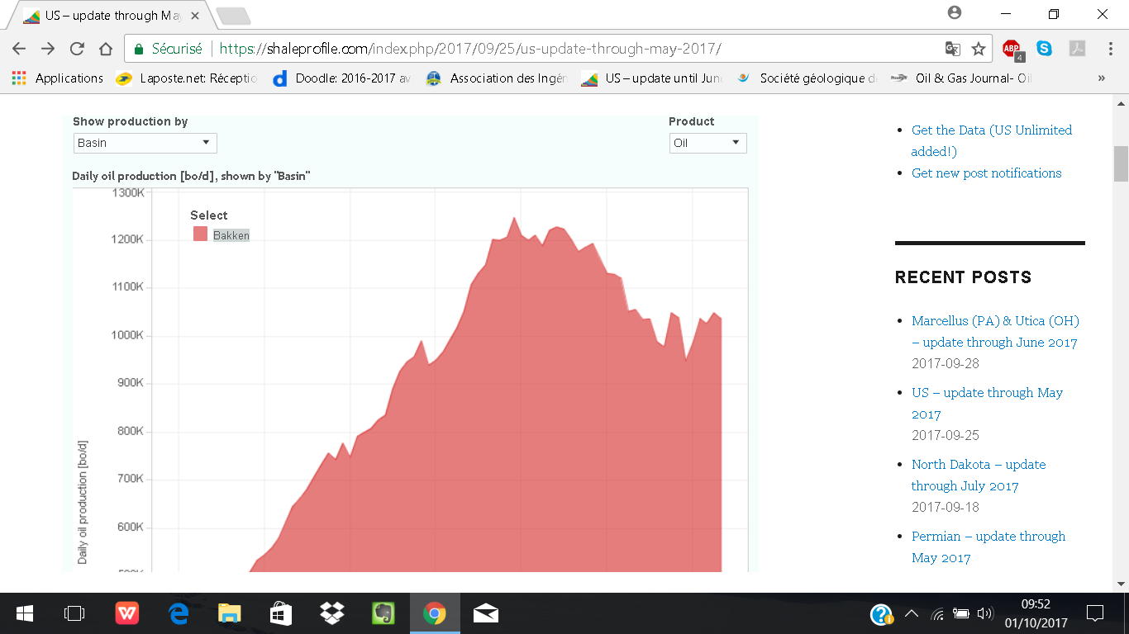
Bakken production : peak between 2014/12 and 2015/6 at around 1220 kbopd ; decline rate at 15%/y ; recent slight increased output (since end 2016) : refracking old wells, new wells : what is a sweet spot ?

Slide 5
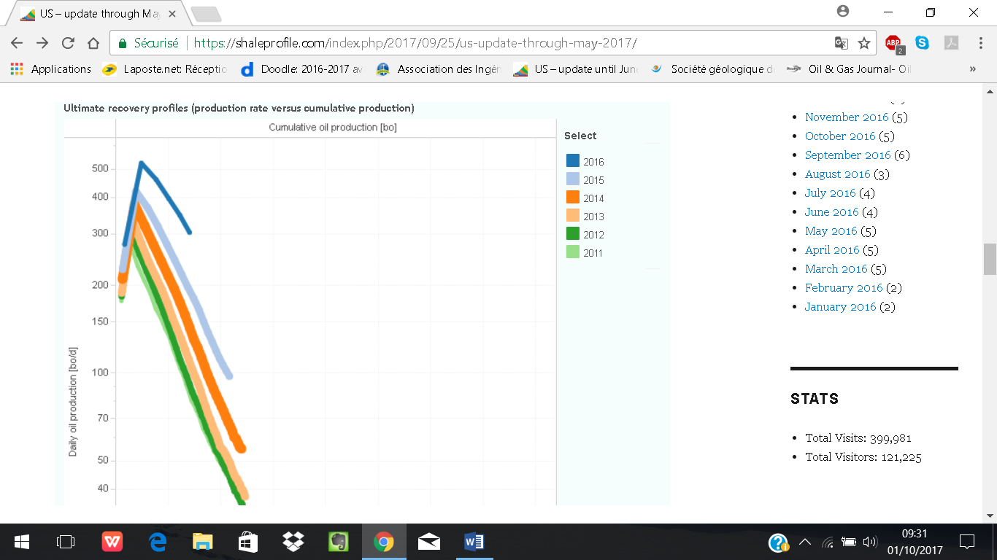
USA LTO Wells : 2011 wells would produce 150 Kbo cumulative production whereas 2016 wells seem far better: 300 Kbo ?
Better area (Permian) ? Better fracking ? What is a sweet-spot ?
50 Kbo
100 Kbo

Slide 6
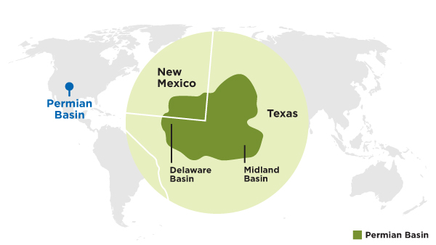
Permian Basin : Majors enhance their positions
ExxonMobil bulks up in Permian
September2017 : US supermajor adds 22,000 acres to positions in Delaware and Midland sub-basins
January 2017 : about 250,000 acres of leasehold in the Permian Basin
Acquisition of companies owned by the Bass family of Fort Worth, Texas, with resource of 3.4 billion barrels of oil equivalent in New Mexico’s Delaware Basin, a highly prolific, oil-prone section of the Permian Basin.
ExxonMobil will make an upfront payment of $5.6 billion in ExxonMobil shares, and additional contingent cash payments totaling up to $1 billion, to be paid in 2020
Chevron targets $4bn Permian push
US supermajor plans major layout in core shale basin to ramp up crude production Chevron total acreage : 2 Millions acres : largest net share holder,
75 000 sqm

Slide 7
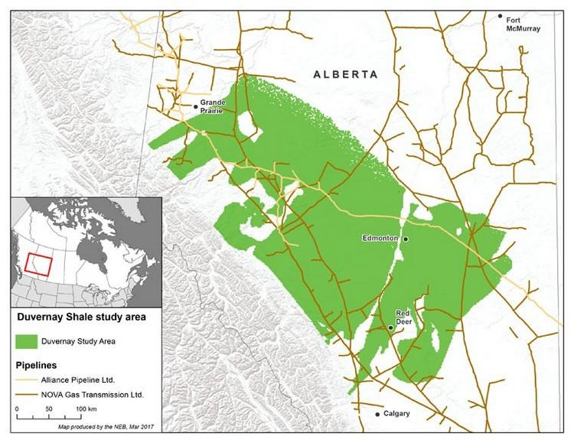
CANADA : Duvernay shale Assesment by NEB (National Energy Board) and AGS (Alberta Geological Survey)
The Duvernay region (300 K sqkm) has the potential to produce 3.4 billion barrels of marketable crude oil and condensates, 6.3 billion barrels of marketable NGLs and nearly 77 trillion cubic feet (Tcf) of marketable gas (be careful : price not indicated)
Companies have been drilling the Duvernay for shale gas and oil since 2011 : deposited about 370 My ago (Frasnian-Famenian), the Duvernay Shale ranges from about one kilometre to more than five kilometres deep. The Duvernay starts getting prospective for oil and gas production below 2.5 km, being oily in areas shallower than 3 km and gassier in areas deeper than 3 km.

Slide 8
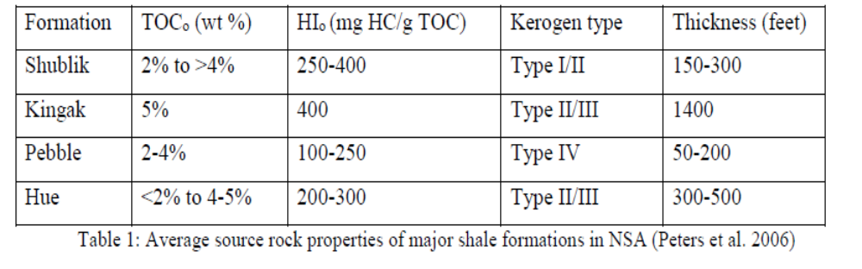
ALASKA Source-rocks
1)The Shublik Formation has sourced 23° to 39° API gravity oil from a mixture of Type I and IIS kerogen; good reservoir candidate, containing brittle rock types (limestone, sandstone, siltstone and chert) .
2)The Kingak and the Brookian shales have sourced higher gravity (35-42° API) oils from predominately Type II and III kerogen. The lower Kingak condensed shale section has high TOC and HI values but mostly plastic clay shale: not be a good reservoir ?
3)The Brookian shale :brittle lithologies such as siltstone, concretionary carbonate, and silicified tuff :better reservoir. These brittle facies, are along with high TOC and HI. The area of highest oil and gas potential is located on State lands between NPRA and the Arctic National Wildlife Refuge (ANWR,) where the thickness exceeds 150m.
Three targets
the Triassic Shublik Formation,
the Jurassic-Lower Cretaceous Kingak Shale
the Cretaceous pebble shale unit and Hue Shale or HRZ Brookian shale.

Slide 9
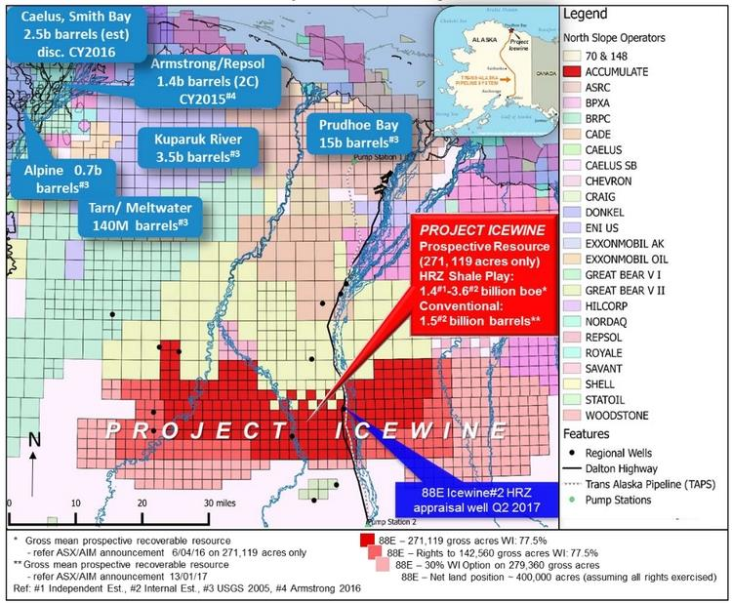
ALASKA Shale Oil Focus : HRZ formation
Icewine-1 well indicate a high-pressure reservoir with good permeability, porosity and low viscosity oil according to 88 Energy,
Another small explorer, Great Bear Petroleum is investigating shale prospects just north of Icewine.
Icewine 2 sarts May 2017 for testing

Slide 10
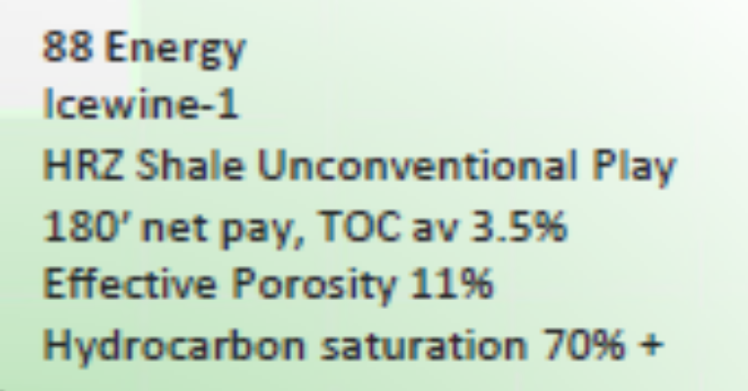
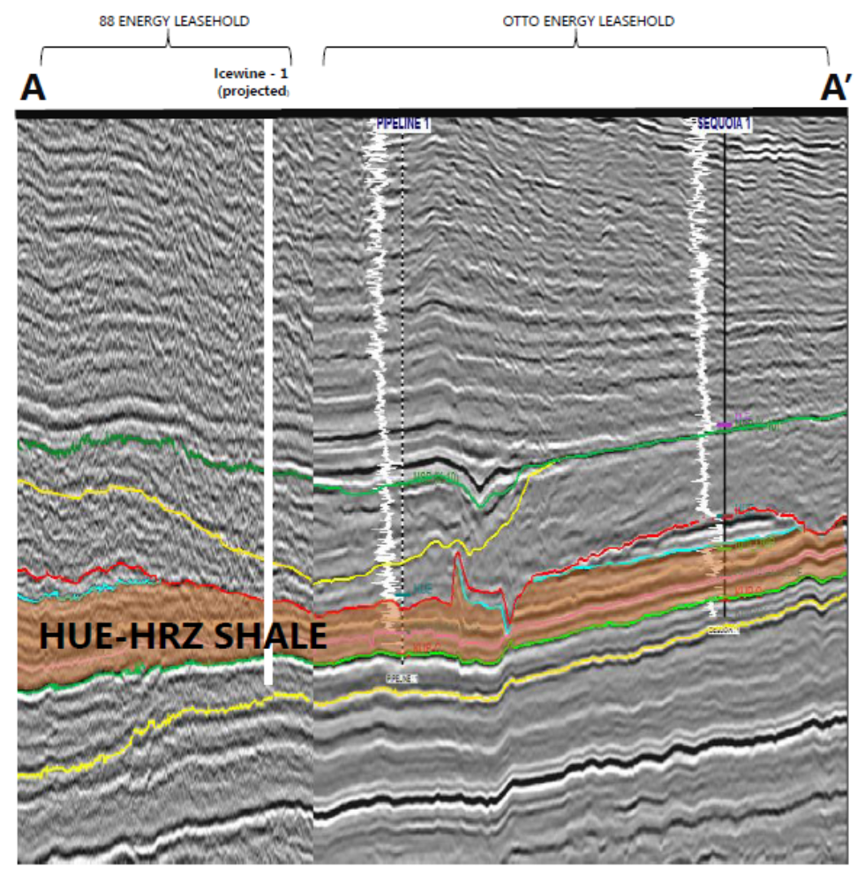
Icewine 1 and 2 wells
Icewine-2 (twin well) Testing Operations Update
The Icewine-2 well was shut-in on 10th July to allow for imbibition and pressure build up to occur within the HRZ shale. Flow testing re-commenced on 31st August at 10:26 (AK time), and is ongoing
Currently flowing back naturally on 8/64 choke at ~55 barrels per day frac fluid
Minor hydrocarbon indications via flow rate of 2-4mcf of gas per day, with a maximum rate of 8mcf of gas per day

Slide 11
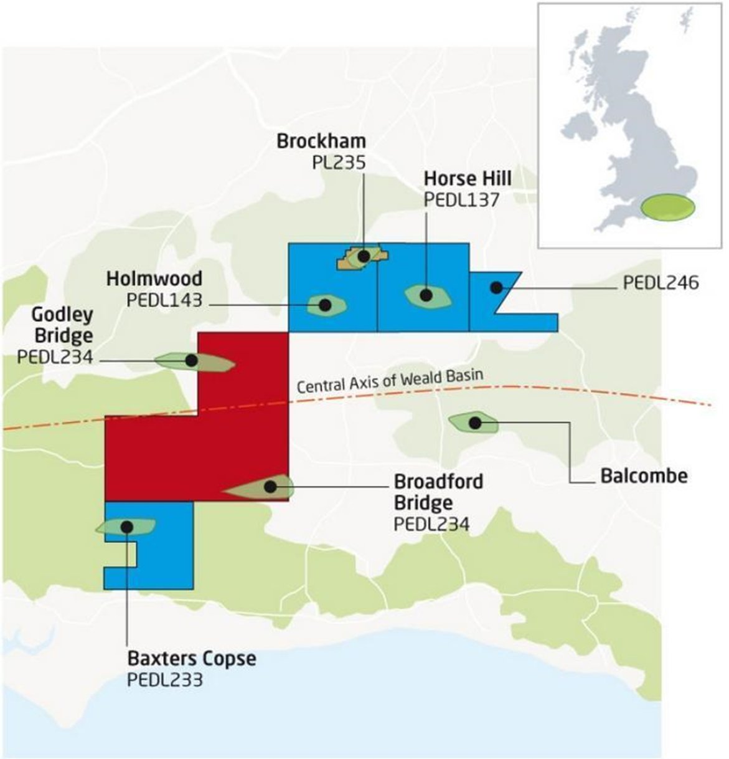
UK Shale Oils and Gas : Weald Basin
UKOG reports further oil seeps from Kimmeridge core samples at Broadford Bridge-1 in PEDL234
UK Oil & Gas Investments (UKOG) has announced that core of 330 ft, has been successfully recovered from the Kimmeridge Limestone 4 ('KL4') target zone at its 100%-owned Broadford Bridge-1 ('BB-1') exploration well. Mobile light oil continued to be observed seeping from multiple sections of fractured KL4 calcareous shales and limestones throughout the cored section
In the Company's opinion, the multiple positive indications of mobile light oil observed throughout the entire naturally fractured KL0 to KL5 target reservoir sections are supportive that a significant continuous oil deposit, with a vertical extent of around 1,400 ft has been demonstrated by BB-1 and 1z.
The licence has been extended to September 2018, enables the company to complete the full 14-week extended flow test programme planned,
In 2016, KL4 and KL3, flowed oil at a stable aggregate rate of 1,365 barrels per day in the Horse Hill-1 discovery near Gatwick Airport.

Slide 12
Australia SG and LTO
Promising signs at Cooper exploration well
Senex Energy plans to test onshore probe next year after hitting signs of gas
Brisbane-based Senex Energy has hit promising signs in the Silver Star-1 gas exploration well in PEL 638 in South Australia’s onshore Cooper basin.
The well was spudded in March this year targeting basin centred gas in the Patchawarra Trough and reached a total depth of 3770 metres in April.
Gas shows were observed in the primary target Patchawarra formation, as well as the Toolachee and Epsilon formations and it was determined the well demonstrated greater potential productivity

Slide 13
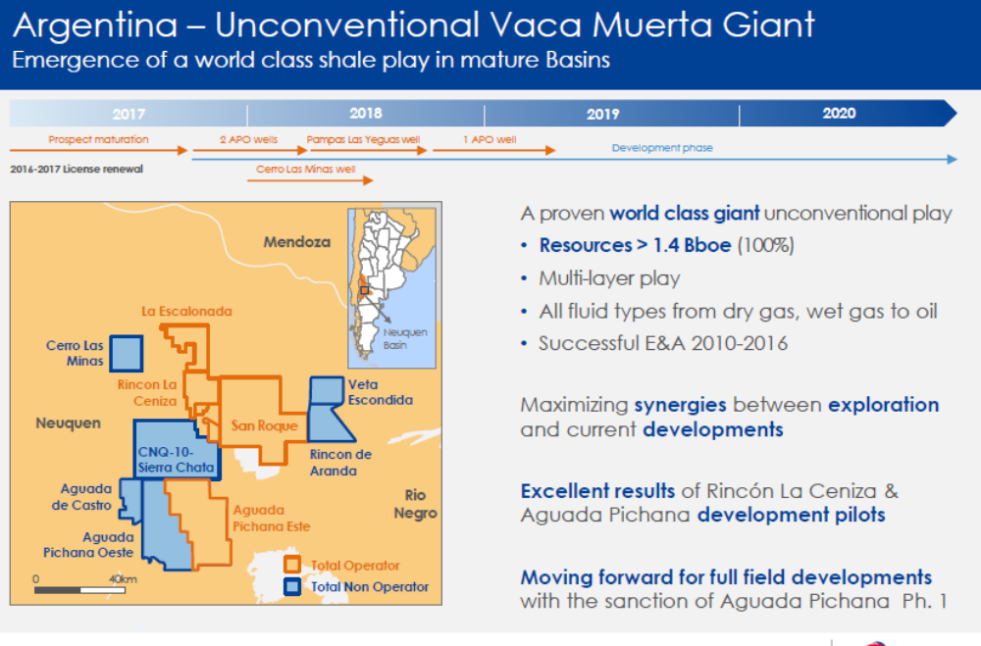
Argentina : Neuquen Basin : Vaca Muerta
TOTAL increases its participation stake in Aguada Pichana East (from 27 to 41 %) following excellent horizontal pilot wells,
Production will sart at 100 Kboepd (16 MMm3/d) with 48 H wells,
Paan American (BP) will operate Aguada Pichana West and Aguada de Castro with 24 H wells,
Vaca Muerta contains 16 Gbo of oil and 300 Tcf of gas according to US EIA on 30 000 km2
Mid 2017 production of LTO accounts for 38000 bopd (8% of total argentinian prod) and 28 MMm3 of gas (23% of total prod),
Well cost (1500 m Horizontal) is at around 8 MM$/w against 15 MM$ in 2014,

Slide 14
Argentina : Neuquen Basin : Vaca Muerta
US supermajor ExxonMobil plans to invest $200 million to boost natural gas output in Argentina's Vaca Muerta shale play, a spokeswoman told Reuters on Friday.
The company has asked the government of Neuquen province for a 35-year unconventional production concession in the Los Toldos I Sur block,
Last year, ExxonMobil said it could invest more than $10 billion in shale projects over 20 to 30 years in the region. ExxonMobil's Argentine subsidiary owns 80% of the Los Toldos I Sur block and is the operator, while Argentine oil company Tecpetrol and province-owned Gas y Petroleo de Neuquen each control 10%.
Investment to this Belgium-sized Vaca Muerta play, one of the world's largest unconventional gas(and LTO ?) reserves, is a key priority for several major companies (Total, Shell, Exxon,+) and YPF,

Slide 15
Russia : Bazhenov LTO
RUSSIAN state-controlled player Gazprom Neft has announced it is ready to move into the next phase of development of unconventional oil reserves located in the Bazhenov deep play below traditional sandstone reservoirs in West Siberia, writes Vladimir Afanasiev.
Speaking this week at the Russian Oil & Gas Congress, Kirill Strizhnev, director of Bazhenov-related projects in the company’s subsidiary Gazpromneft-Angara, revealed an ambitious drilling programme planned for 2018-2025.
The goal is to produce 73 million barrels of light oil annually (200 Kbopd),

Slide 16
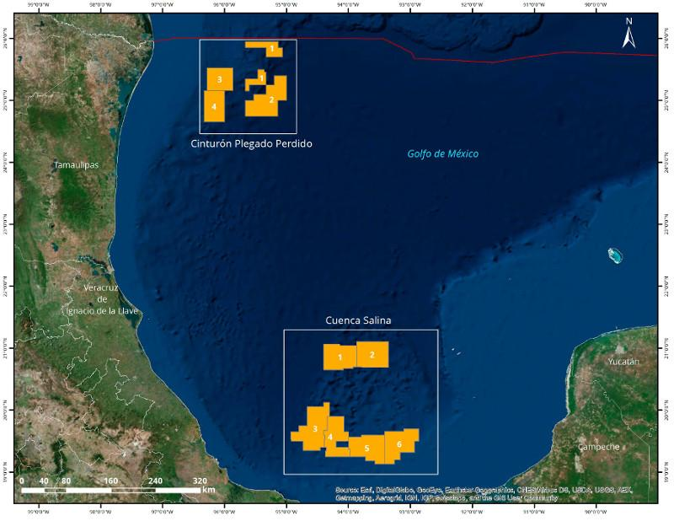
Deep offshore Mexico First Round
The Round 1.4 brought the biggest contenders yet following Mexican reforms passed in 2014 to end the monopoly of state oil company Pemex and bring in private companies, a push to increase investment and technology. 8 blocks awarded :
Perdido fold-belt areas:
1: CNOOC Ltd.
2: Total/ExxonMobil
3: Chevron/Pemex/Inpex
4: CNOOC Ltd.
Salina basin areas:
1: Statoil/BP/Total
3: Statoil/BP/Total
4: Petronas/Sierra
5: Petronas/Sierra/Murphy/Ophir

Slide 17
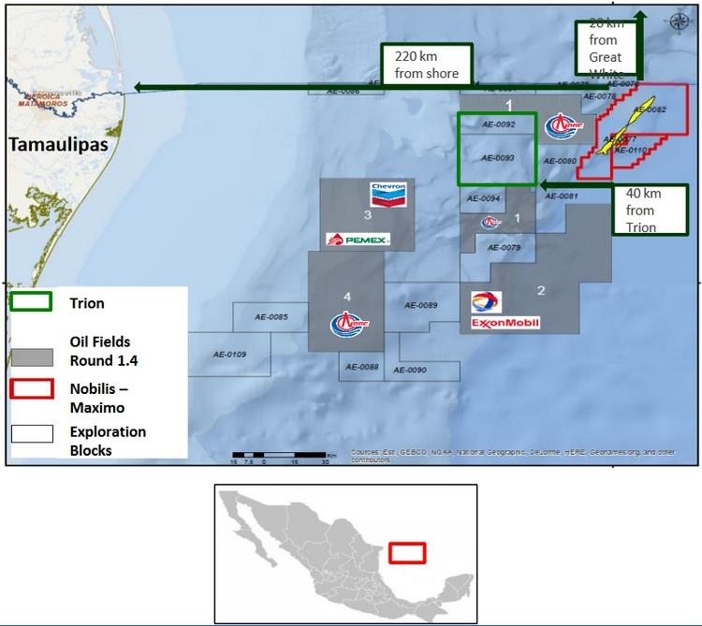
First Mexico DRO Round in the Perdido Fold Belt
Australia's BHP Billiton is set to become Pemex's first full-fledged international partner via a farm-in of the deep-water Trion discovery, having emerged as the high bidder with a $624 million tie-breaking bonus bid to beat out rival BP.
Commitment : 300 MM$ ; two wells
Pemex is seeking partners for the Maximino-Nobilis deepwater area in the Gulf of Mexico, estimated to contain total 3P reserves of 500 million barrels of crude oil equivalent. With a water depth between 2, 900 and 3, 100 meters, it covers a total area of 1,524 sq kms.

Slide 18
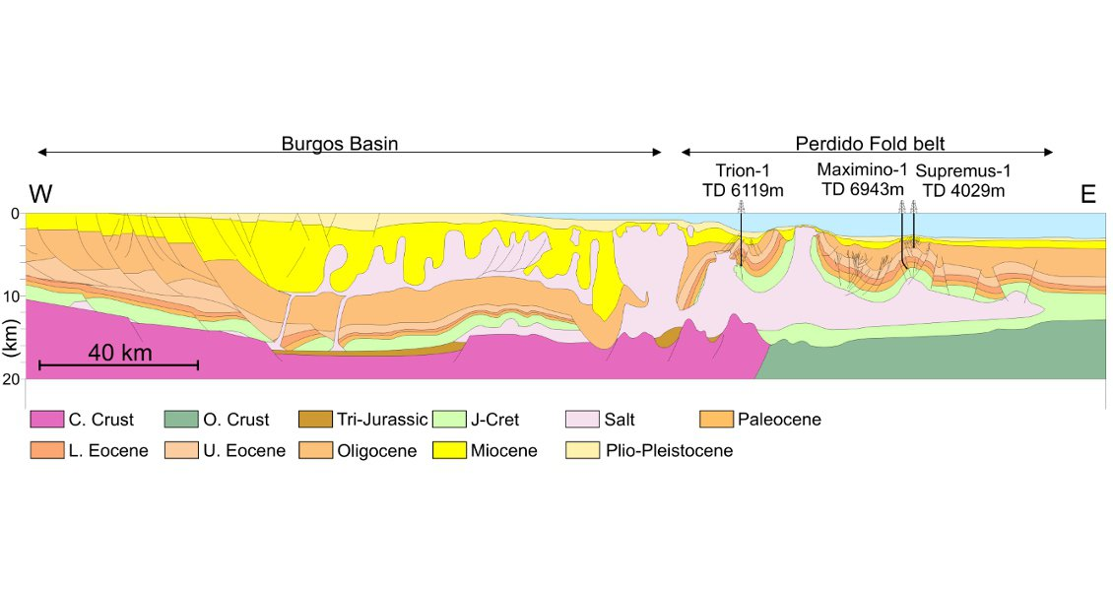
Perdido Folded belt : structural context
Total-Exxon Area 2

Slide 19
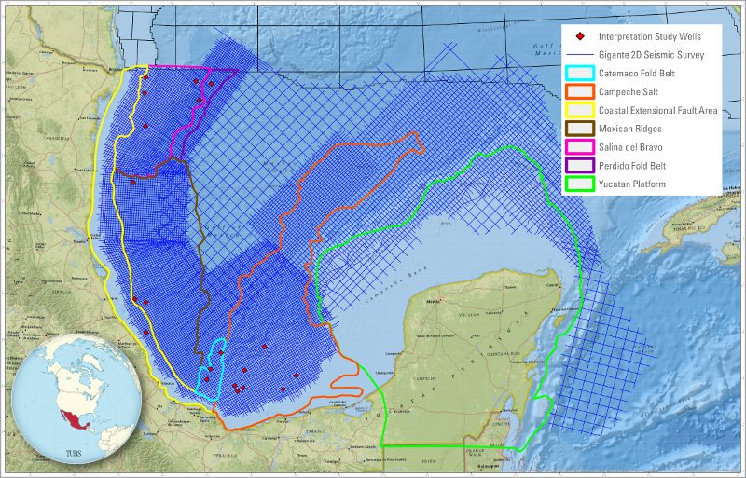
Mexico Next Deep waters ( 2ndRound)
July 2017,Mexico's oil regulator, the National Hydrocarbons Commission, has set Jan. 31 2018 as the date for the next round of auctions for deep-water oil and gas tenders in the Gulf of Mexico.
The so-called 2.4 auctions will offer 30 areas, of which 10 are in the Cordilleras Mexicanas deepwater basin, 10 others in the Salina Basin, nine in the Perdido Fold Belt off the U.S.-Mexico maritime border and one more in the Yucatan platform.
The Cordilleras Mexicanas deepwater basin is home to national oil companyPemex's Lakach natural gas project and located east of the Gulf Coast port of Veracruz.
Cordilleras Mexicanas is viewed by the oil and gas industry as having extensive untapped potential

Slide 20
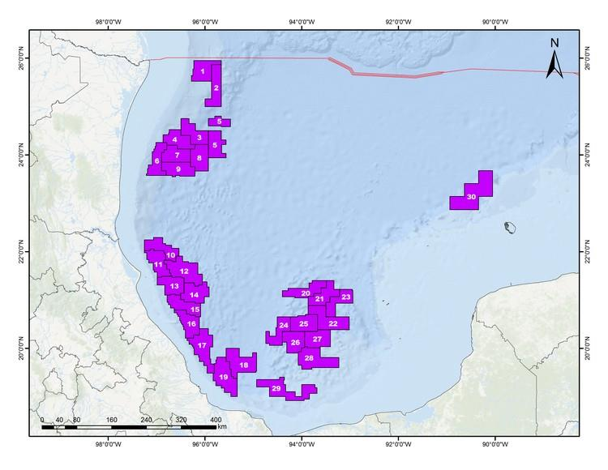
Mexico DW 2nd Round :30 blocks in offer

Slide 21
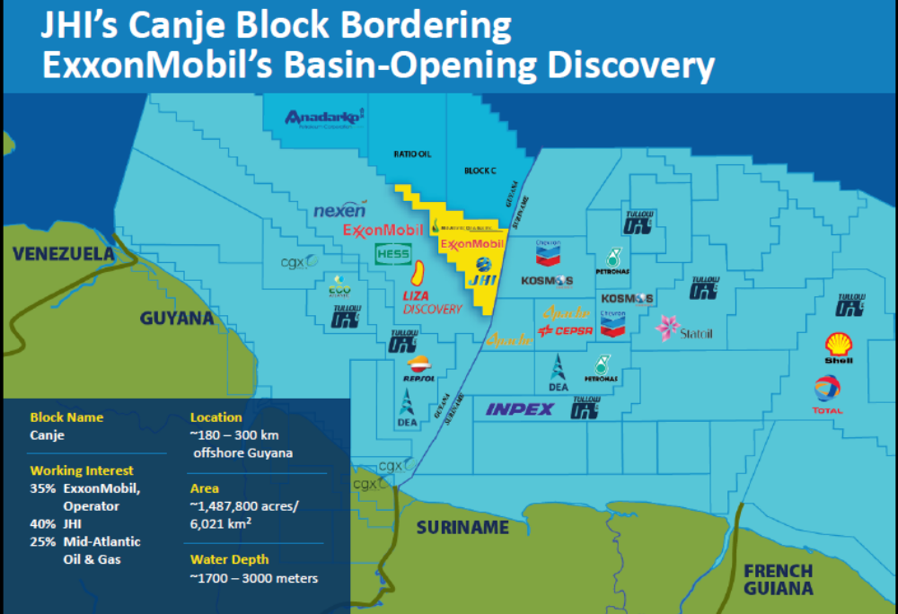
Around Lizza : a tremendous new acreage activity
Block 59
Exxon (op, 33%), Statoil (33%) and Hess (33%) enter in Surinam ; wd : 2000 to 3500 m !
KAITEUR Block
EXXON 50%- Ratio Energy 50%
5000 sqkm 3D Campaign by Polarcus
CANJE Block
EXXON (35 %)-JHI (40 %)-Mid Atlantic (25 %)-
7700 sqkm 3D SEISMICS shot by Polarcus
Tullow Oil (op, 60%) : 2500 sqkm Western 3D Campaign in progress
Platform : SNE Senegal Type ?
TOTAL farms in 25 % from Eco Atlantic

Slide 22
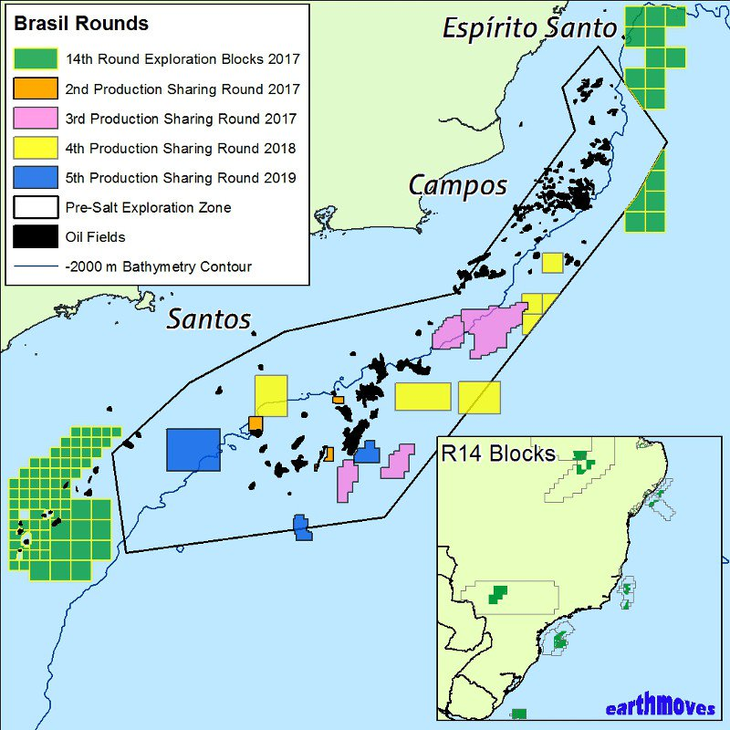
BRAZIL 14th Round
The Brazilian Government has recently confirmed the blocks to be offered in the 14th Exploration Round and proposed areas for the 2nd and 3rd Production Sharing (Pre-Salt) Round in September and October 2017.
Four large attractive areas have been marked for this Production Sharing Round, where carbonate reservoirs are expected and large structural highs present. Four DRO (Gato de Mato, Carcara, Sapinghao, Tartaruga Verde) and 4 explo blocs (Alto Cabo Frio Oeste, Central, Pau-Brasil and Peroba)
The Exploration Round 14 offshore blocks are situated in the Pelotas, Santos, Campos, Espírito-Santo and Sergipe-Alagoas Basins. The Santos blocks are mainly located in the shelfal area, and several oil fields have recently been discovered nearby. The Pelotas blocks are frontier terrain with no wells drilled in this part of the basin. All the other deepwater(>2,000m) blocks are located downdip from major oilfields, where turbidite sandstone reservoirs can be expected in potential stratigraphic and structural traps.
The government has reduced the local exploration cost content to 50%, and Petrobras no longer has an exclusive right to participate in the Pre-Salt blocks. These highly significant legislative changes and the attractive array of offered blocks will surely lead to a resurgence in Brazilian exploration in the next three years.

Slide 23
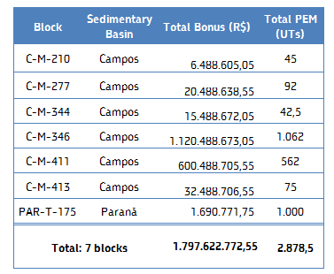
BRAZIL 14th exploration round results (09/27/2017)
Very important sucess with largest total signature bonus in the Brazil history : 1,3 G$ and above all the largest single one : 700 M$ for CM-346 for Exxon and Petrobras,
A large cooperation between Petrobras (operator) and Exxon (6 blocks in Campos)
Exxon new comer ! In Brazil (and in exploration in South Americas)
37 blocks (8 basins) acquired by 17 winning compagnies
Expecting a highly competitive presalt round end of October 2017 !
Petrobras/Exxon association

Slide 24
Norway : Barents Sea Round under scrutiny
Norway is offering a record number of blocks in the Barents Sea under its 24th licensing round defying environmental concerns over exploitation of hydrocarbons close to the Arctic ice boundary.
All of the 102 tracts originally proposed - 93 in the northern Barents and nine in the Norwegian Sea - are being tendered for oil companies as Petroleum & Energy Minister Terje Soviknes fired the starting gun for bidding in the controversial round.
This is despite a consultation exercise in which the country’s Environment Agency (EA) called for 20 blocks within 100 kilometres of the Bear Island nature reserve in the Barents to be withdrawn from the round.
The EA had highlighted concerns over bird life and the ice boundary due to the risk of an oil spill, while also calling into question emergency response capability in the event of such an incident (not far from Greenpeace opinion willing to halt artic exploration),
The agency has also called into question the long-term commercial viability of developing potential finds in the proposed blocks given the high development costs in the remote Arctic region with a lack of existing infrastructure and long distances from shore.
The government received 36 responses in the consultation process for the blocks that were originally nominated by oil companies.
The bidding deadline for the round is 30 November 2017 with awards expected in the first half of 2018.

Slide 25
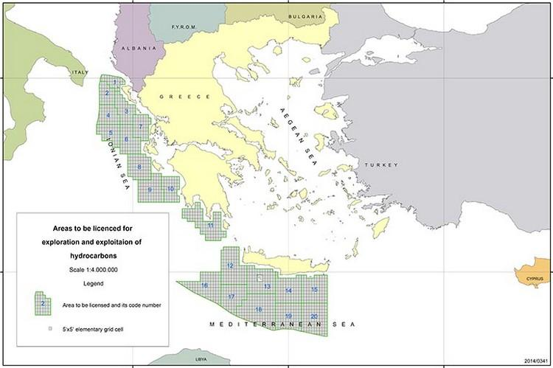
New Fontier in Europe : Greece (and Albania (open) and Montenegro (ENI awards : 4 blocks)) New acreages : Dinarides and South Kreta
Repsol 60% enters Ioannina onshore blocks
Offshore Block 2 : TOTAL
Zohr Type ?
Carbonates below Messinian Salt ?
Exxon and TOTAL interested in direct negociations,,,

